Slide 1
Welcome
We are the Wandsworth independent champion for local people to share their views on publicly funded health and social care
We promote and support involvement of the public in health and social care
We will record this meeting – please turn off your camera if you don’t want to appear
Mute during presentations
Remember to unmute when its question time
Any questions can put them in the chat box
Presentations will be available after the event

Slide 2
Today’s event:
Discuss future priorities for public and patient involvement in health and social care

Slide 3
Patient and public involvement
Why talk about this?
The NHS has a duty to involve patients in their health and care. Mark Creelman will tell us more shortly.
Things have changed a lot recently. Services have been working differently and may need to evolve further as we move through the pandemic.
Over the last year we have learnt a lot as individuals/patients and so have the people trying to provide services.
We all have a continuing need to manage health and care and can draw on those experiences to help make things better. Involvement is important to ensure developments in services are right for the people they serve.

Slide 4
Healthwatch role
Independent local champion to make sure there are opportunities for people to be involved and informed about health and care services and developments to those services.
We speak to local people and listen to their experiences.
We encourage the people in charge of health and care services and support them to involve people, making sure this is high on the agenda.
We encourage others like the NHS CCG to involved patients and the public. However, if important areas might be best looked at by us as an independent body or if topics are not being prioritised by others, we aim to gather views to address these areas.
Find out more: https://www.healthwatchwandsworth.co.uk/what-we-do

Slide 5
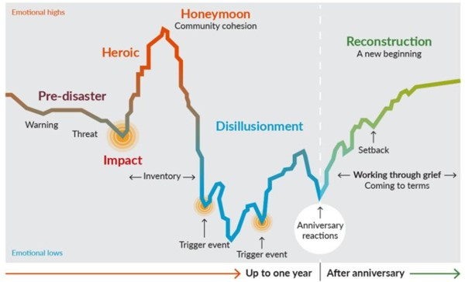
Aim of this event
No one knows exactly how things will work out in the coming months.
The Kings Fund provided this diagram based on discussions with people involved in disaster recovery around the world (https://lnkd.in/dasQP3E)
Despite the uncertainty and the ups and downs, as Healthwatch we need to find a way to focus and prioritise on a few things important to local people that their voice can contribute to.

Slide 6
Pre-election and purdah
Healthwatch is non-political and independent: we have to protect this
London Mayoral elections are scheduled for Thursday 6 May so we are in a period of pre-election period known as purdah
We want to be careful to avoid anything which might appear party political in nature
Please respect this during our event today: avoid sharing political views or using the event for political means

Slide 7
Agenda
2:00 | Introduction – Stephen Hickey – Healthwatch Wandsworth Chair
2:10 | Patient and public involvement in Wandsworth - Mark Creelman, Locality Executive Director (Merton and Wandsworth) & Naomi Good, Engagement Manager.
2:35 | Healthwatch Wandsworth Priorities for the year ahead
2:55 | 5 min comfort break
3:00 | Introduction to breakout topics
3:05 | 3 breakout groups (25 mins each): 1. Your experiences of managing health and care 2. Working with Communities in Wandsworth 3. Hospital discharges
4:25 | Closing feedback

Slide 8
Reminder:
We will record this meeting – please turn off your camera if you don’t want to appear
Mute during presentations
Remember to unmute when it is question time
Any questions can be put in the chat box
Presentations will be available after the event
Purdah

Slide 9
Patient and public involvement in Wandsworth
- Mark Creelman, Locality Executive Director (Merton and Wandsworth) & Naomi Good, Engagement Manager.

Slide 10
Healthwatch Wandsworth Priorities for the year ahead

Slide 11
We invite people to speak to us about health and social care regularly.
People can contact us at any time to share their story or can leave feedback on our website.
Our staff and volunteers identify what matters most to people by:
Visiting services to people using the services to see how they are working.
Running surveys and focus groups.
Going to community events and groups and working with other organisations to hear from local people.
Hosting our own free public events.
Reporting and presenting local people’s views.

Slide 12
Since April 2020 we have
• Surveyed local people about their experiences of accessing health and social care and managing during the pandemic.
• We worked with Voicing Views and Talk Wandsworth NHS services to see how virtual ‘wellbeing workshops’ can be run and relevant to groups in the community during this time.
• We worked with the CCG to hear experiences of digital and telephone appointments, including focused interviews with elderly residents, people with learning disabilities and people with autism. Over 500 people took part.

Slide 13
• We worked with the CCG to gain feedback from care home staff and 129 people took part.
• We took part in national work to understand experiences of hospital discharge.
• We held a public Assembly meeting about health inequalities in September, our first assembly online.
• We launched a survey to understand experiences of new parents trying to access mental health support services in the last 12 months.

Slide 14
What next? Priorities for 2021
To decide where we focus next:
We look at all of the experiences people have shared over the year throughout our work
We ask people about recent experiences and what is important to them in a survey (currently open)
We gather information about what the health and care system will be working on and look at other information about the local and national picture

Slide 15
What next? Priorities for 2021
So far, the following are emerging themes we will choose from:
Consistency of communications and understandable information
Communications between services and centralised access, esp. appointments and support for carers
Use of digital technology or remote appointments
Hospital discharges – esp. regarding communication
Carers – supporting people with additional needs, adapting to remote services, mental health.
Impact on mental health, NHS support or support from family and friends (especially dementia and LD)
Re-establishing services and lifestyles, access to services and appointments

Slide 16
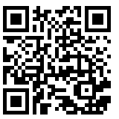
What do you think
Quick poll
Complete our survey – if you can spare 10 – 15 minutes to share your experiences of managing your health and care during the coronavirus pandemic and what is important to you in 2021 (also a chance to win £100 shopping voucher!)
Scan this code with your phone
Or type in this weblink: www.smartsurvey.co.uk/s/CV2Assembly

Slide 17
Discussion sessions
We will arrange for everyone to be in a group to discuss each of the 3 topics.
To make this as easy as possible for us and you to manage, we will put people into ‘virtual rooms in groups’.
The presenters/facilitators for each topic will spend a 25 minute session with each group.
After each session the presenter/facilitator will change group.
If you want to take a break, put yourself on mute/turn off your camera and look out for when the next presenter arrives for the next session.

Slide 18
Break time

Slide 19
1. Your experiences of managing health and care
Delia Fitzsimmons and Elena Ahmed, Healthwatch Wandsworth
2. Working with Communities in Wandsworth Naomi Good, Engagement Manager, NHS Wandsworth.
3. Hospital discharges Sandy Keen, Assistant Head of Transformation – Integrated Care, Wandsworth NHS South West London CCG, Sarah Cook, Healthwatch Wandsworth.
Please click - join breakout group session
Notes:
We value your experiences and knowledge

Slide 20
Closing feedback
Notes:
TBD

