Slide 1
Presentation by Ije Amaechi
Community Development Worker
At Wandsworth Healthwatch Assembly 24 October 2024

Slide 2
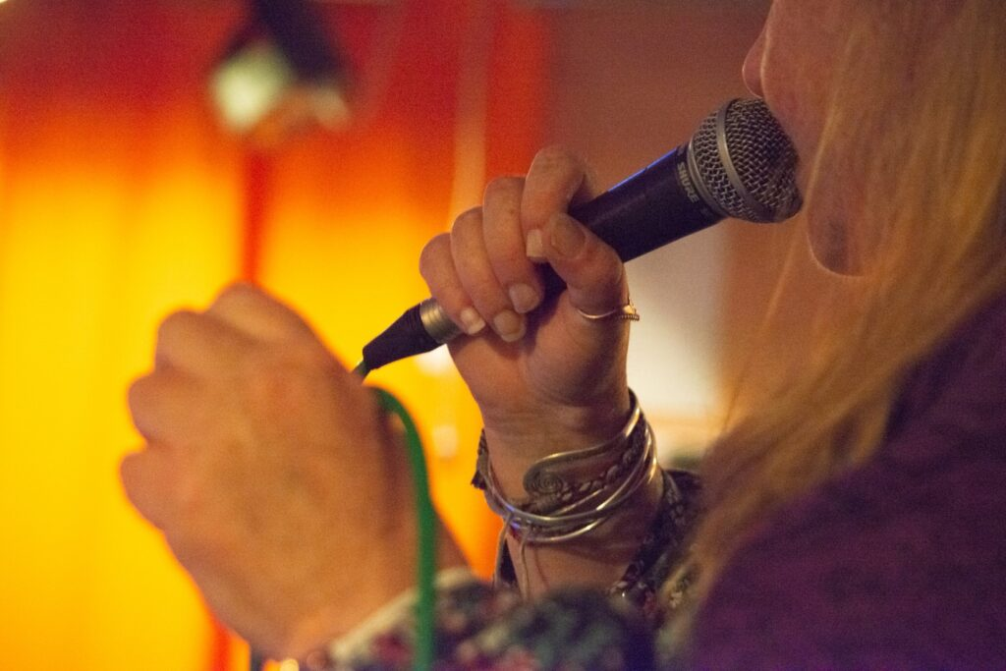
Our vision
Sound Minds is a mental health charity transforming lives through music, film and art.
We are a thriving community bound together by creativity and a shared belief in mutual learning and peer support.
Every person with mental health problems in South-West London can have access to high quality artistic activity and peer support.

Slide 3
Values
We are member-led.
We are strongly embedded in our local community.
We are creative, respectful, supportive, non-judgemental and tolerant.
We are person-centred and tailor provision to the needs of the individual so that they can reach their potential.
We nurture and take pride in an inventive and adaptive approach to working with people with mental health problems.
Music is at the heart of what we do but we prize all forms of artistic endeavour and peer support.

Slide 4
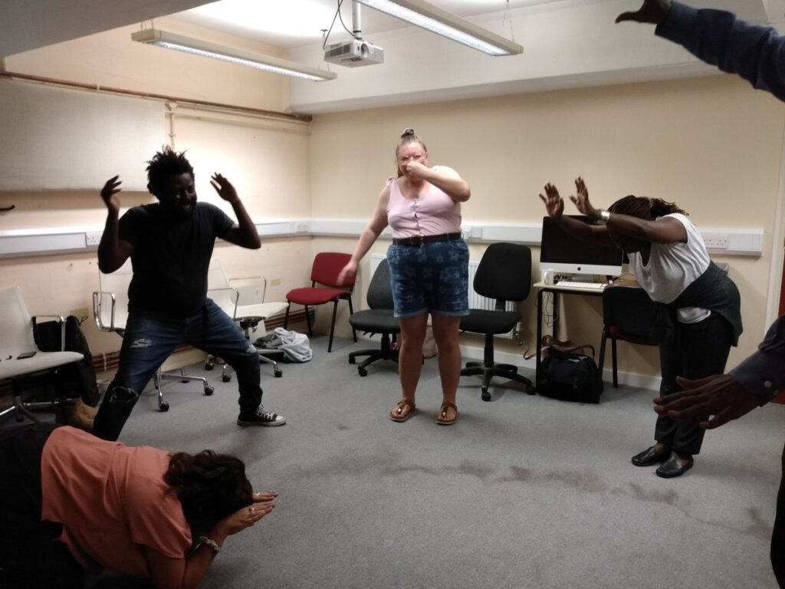
Mission
To offer a safe and sociable environment where people with lived experience of mental health problems find support from understanding peers, renew aspirations and self-esteem and are stimulated and empowered to express ourselves artistically.

Slide 5
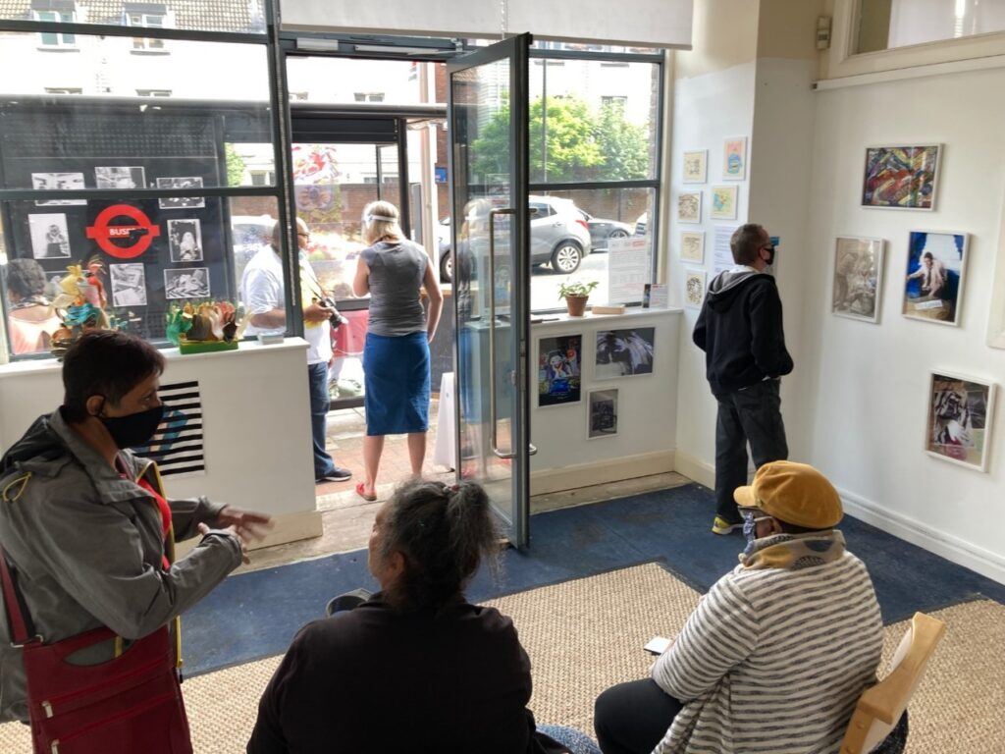
Who we work with
Sound Minds works with people with lived experience of mental health problems including those that are mental health service users. Members come from across the spectrum from mild to serious mental illness.
Our core group of members is those with serious mental illness, and in particular those who have experience of being inpatients on psychiatric wards.
We have a particular focus on working with black people who are systemically discriminated against in mental health provision and disproportionately represented.
Notes:
We work with any organisation that is genuinely committed to helping us achieve our mission as long its activities do not compromise, directly or indirectly, the mental health of those involved with it, or of society at large.
We do not work with or accept money from firms involved in pharmaceuticals, oil, tobacco, or arms, or organisations substantially funded by them.

Slide 6
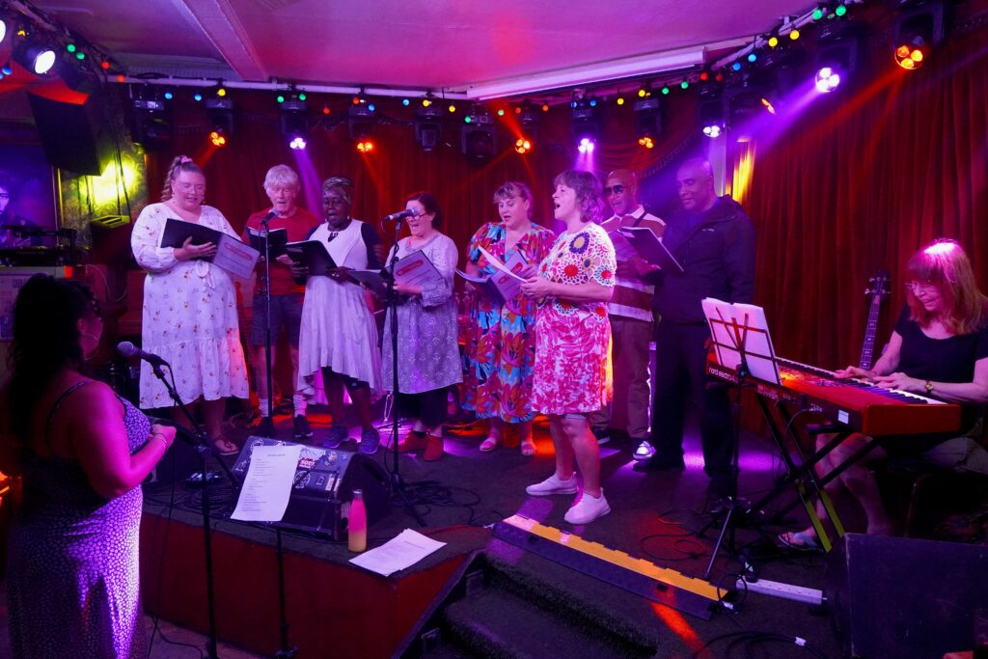
Music and arts provision at Sound Minds
121 tuition – vocal, guitar, drum lessons
Jam, DJ, Breathe (for 18-25 year olds), music production sessions
Studio hire by members
Bluesology band, Reggae bands
Art studio on Tuesdays and Fridays
Community Choir
Drama group
Creative development and pastoral support 121s for members
Mama Low’s at Katherine Low Settlement
Between 1 April 2024 and 30 August 2024, we provided 358 sessions with 1051 participant engagements

Slide 7
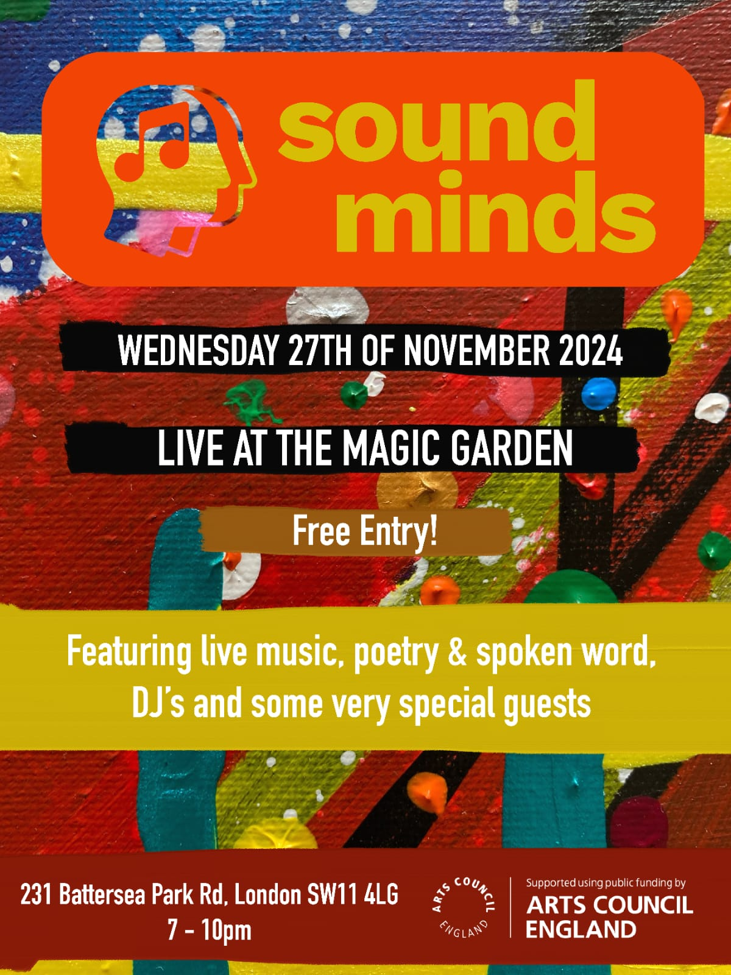
Gigs and exhibitions
Gigs are central to the work of Sounds Minds - they showcase our talent, give our members something to work towards, provide valuable performance experience and raise the profile of the organisation.
We aim to deliver at least one internal gig and one external gig each quarter.
Come along to our next gig is November 27th at The Magic Garden:
featuring live music, poetry and spoken word, DJs and some very special guests– free entry

Slide 8
Partnership working
Sound Minds works with a wide range of partners, across sectors, and recognises the importance of partnership working to achieve our mission, vision and objectives.
We are open to working with all individuals and organisations who share our values and continuously, and proactively, look to form new relationships.
We do not work with or accept money from firms involved in pharmaceuticals, oil, tobacco, or arms, or organisations substantially funded by them.
The Battersea Central Methodist Mission are our landlords and have been a longstanding supporter of Sound Minds.

Slide 9
Canerows – peer support network
Canerows offers peer support to people who have recently left hospital and those needing short term support in the community.
User led service working to improve the lives of people who are overcoming mental health issues, particularly people from black and minority ethnic backgrounds who are over-represented in the mental health system.
Our Peer Support Workers use their own lived experiences to give emotional support to others and promote access to information and practical advice to people experiencing mental health difficulties.
“After meeting my peer support worker, I finally felt that someone really understood what I was going through”
“My peer support worker made me feel that I could get better, they put me at the centre of the work and helped with things based on my own decision making

Slide 10
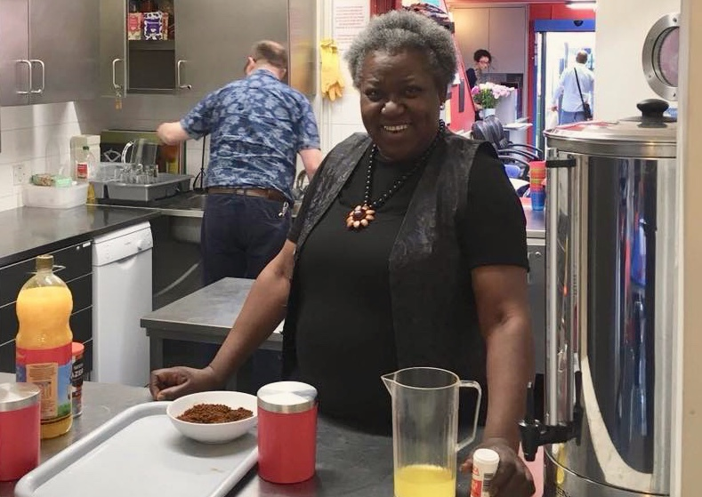
Mama Low’s
Mama Low’s Kitchen is a user led drop-in based at the Katherine Low Settlement.
Mama’s is open every Friday throughout the year 10am-2:30pm
As well as a low-cost meal there is internet access and peer support, and a programme of outings and other activities.
Mama’s is open to Wandsworth residents only and is free to attend once referral to Sound Minds has been completed.

Slide 11
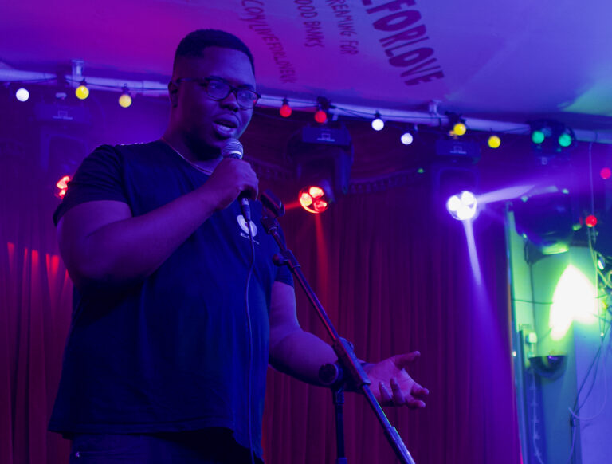
Impact
● Our 2023 member survey showed that 100% of members rated their experience of Sound Minds as excellent/good and that:
● 80% agreed their mental health had improved.
● 56% agreed that they met more people socially and felt less isolated.
● 72% agreed that they had increased resilience and better coping mechanisms.
● 80% felt that their life had more sense of purpose.

Slide 12
Participant interview – Art
Q. What has been your overall experience of the art sessions?
It’s been a positive one. It’s reignited a spark within me to be creative and given me confidence to think about being creative and express myself. I wasn’t sure before coming along, I mentioned to my social prescriber that I liked art and she got me a place and here I am and it’s been good. It’s also good that no one is questioned as to why they are there, everyone is just allowed to be.
Q. How would you define your mental health problems?
I’m in a much better place than I was, I feel a lot happier and things aren’t so insurmountable. I’m still taking the depression meds. It’s taken me a while to get here, I started going downhill about 5 years ago but I’m in a much better place than I was. I think this has helped, meeting strangers always helps because no one knows you and you can just be yourself.

Slide 13
Thank you for listening
You can contact me at ije.amaechi@soundminds.co.uk
Or our staff email staff@soundminds.co.uk
We welcome referrals to Sound Minds and the different projects we have on offer
(you can also self-refer)
soundminds.co.uk/referrals/
020 7207 1786
20-22 York Road, Battersea,
London SW11 3QA

